Slide 1

Introduction to Disaster Management
Disaster management is a complex and multifaceted field that encompasses a range of activities aimed at mitigating the impact of natural and man-made disasters. It involves preparedness, response, and recovery phases.
Prepared By Yash Tripathi & Group

Slide 2
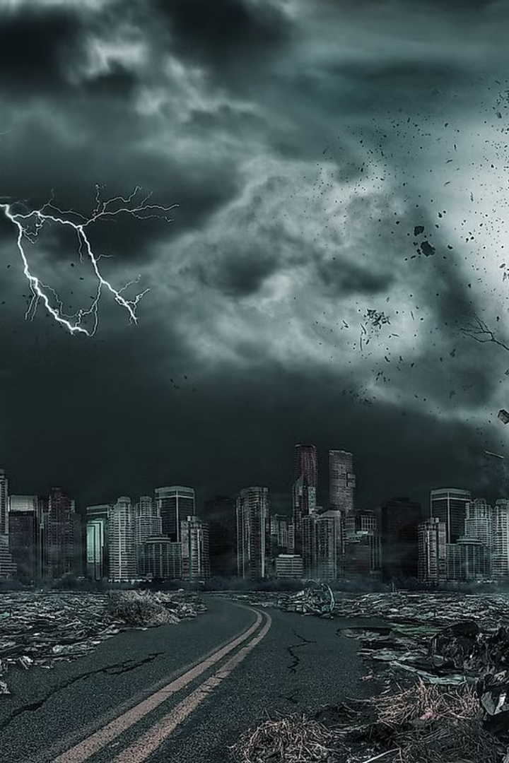
Types of Natural Disasters
1
Earthquakes
2
Floods
Earthquakes are sudden and violent shifts in the Earth's crust, causing widespread damage and loss of life.
Floods occur when rivers or other bodies of water overflow their banks, inundating surrounding areas.
3
Wildfires
4
Hurricanes
Wildfires are uncontrolled blazes that spread rapidly, consuming vegetation and structures.
Hurricanes are intense storms with high winds, heavy rainfall, and storm surges that can cause catastrophic damage.

Slide 3

Disaster Response Coordination App
This app helps communities respond to emergencies efficiently by coordinating resources and connecting people with information.
Prepared By Yash Tripathi & Group

Slide 4
Key Features
Real-Time Incident Reporting
Communication Platform
Resource Mapping
Report emergencies and provide updates.
Secure communication for responders, volunteers, and the community.
Visualize resource and personnel locations.
Volunteer Coordination
Organize and mobilize volunteers for tasks.
Prepared By Yash Tripathi & Group

Slide 5

Technologies Used
Front-End
React or Flutter
Back-End
Node.js with Express or Python with Flask
Database
MongoDB or Firebase
Mapping
Google Maps API or Mapbox
Push Notifications
Firebase Cloud Messaging

Slide 6




Target Users
Emergency Responders
First responders, such as firefighters, police officers, and paramedics.
Local Governments & NGOs
Government agencies and non-profit organizations involved in disaster relief efforts.
Community Members
Residents of the community who are affected by or want to help during a disaster.

Slide 7
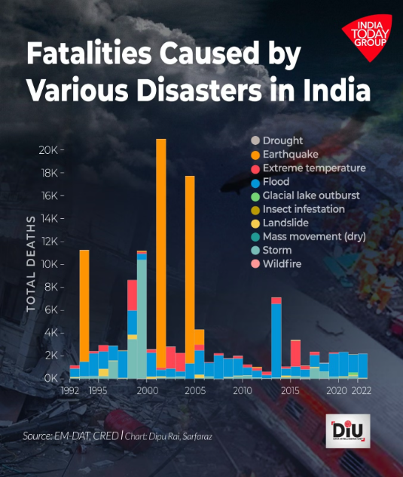


Impact
Streamlined Communication
The app facilitates clear and efficient communication between all stakeholders.
Enhanced Community Preparedness
The app empowers communities to be more prepared for emergencies.
Improved Resource Allocation
Real-time resource visibility ensures efficient deployment and utilization of resources.
Prepared By Yash Tripathi & Group

Slide 8

Roadmap
Research
1
Understanding the needs and challenges of disaster response.
2
Design
Designing a user-friendly interface and user experience for the app.
Development
3
Building the front-end and back-end functionality of the app.
4
Testing
Rigorous testing to ensure the app's functionality and reliability.
Deployment
5
Making the app available for users.
Prepared By Yash Tripathi & Group

Slide 9

Conclusion & Key Takeaways
Effective disaster management is essential for protecting communities from the devastating impacts of natural disasters. Through technology and collaboration, we can enhance preparedness, response, and recovery efforts, building more resilient communities.

